Slide 1
MetroMove Transit Solutions An Exploratory Data Analysis of public transportation
Presented By
Fanta Conta

Slide 2

Presentation Outline
Introduction
Data Cleaning & Exploration process
Descriptive Statistics
Univariate/Bivariate/Multivariate Analysis (Visualizations)
Conclusions
Recommendations

Slide 3
Introduction
MetroMove is a public transportation organization that collects trip data that lacks data – driven initiations.
The company’s objective is to have their data cleaned, explored and to be provided with a summary of the collected data.
The decision-making relies on:
1. Understanding passenger usage patterns.
2. Evaluating the performance of different transport modes.
3. Analyzing how trip characteristics impact customer experience.

Slide 4
Steps & Process for the Exploratory Data Analysis (EDA)
1. Importing Libraries
2. Checked Data Distribution
3. Worked on Missing Values
4. Checked for Spelling errors & spaces
5. Filled the missing values
6. Confirmed that data was cleaned
7. Carried out detailed Analysis
8. Visualizations
9. Insights, Conclusions & Recommendations

Slide 5

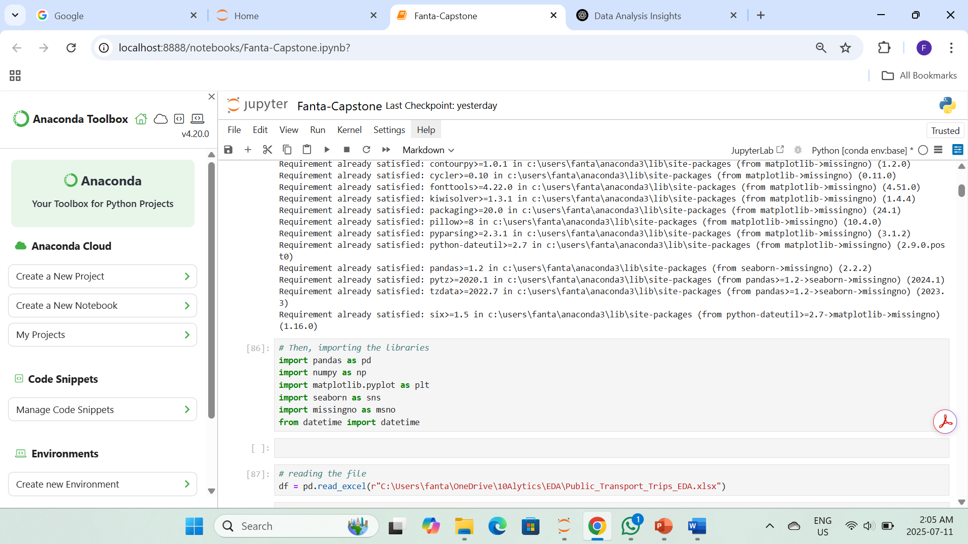
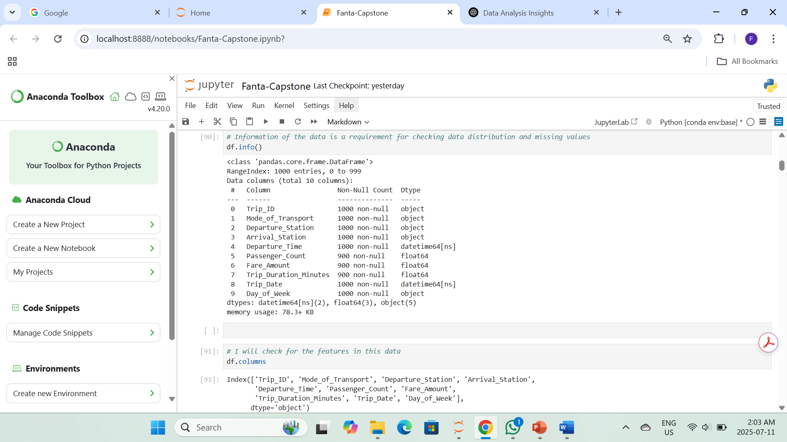
Importing libraries & evaluating the data

Slide 6
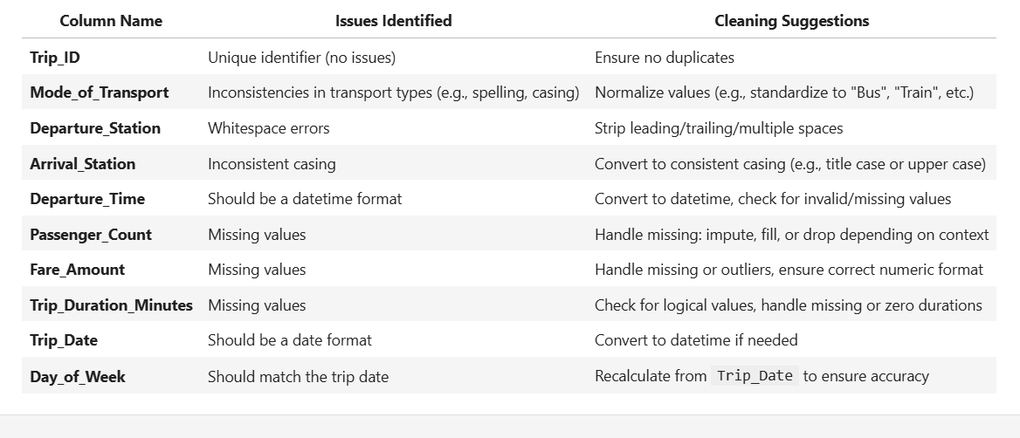
Features, Identifying Issues and Suggestions

Slide 7
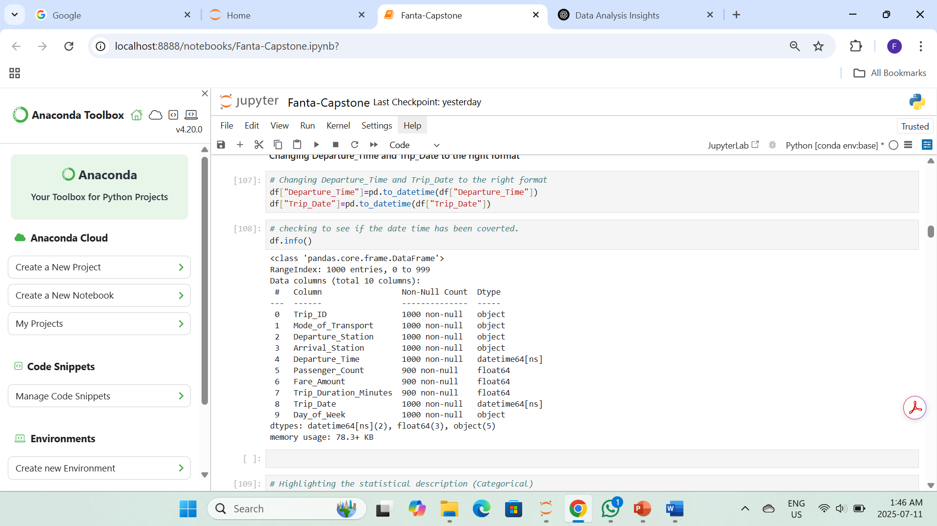
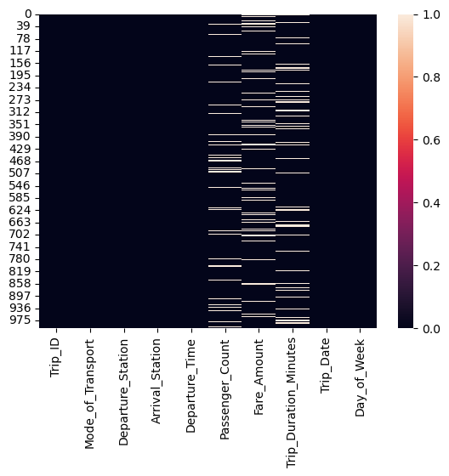
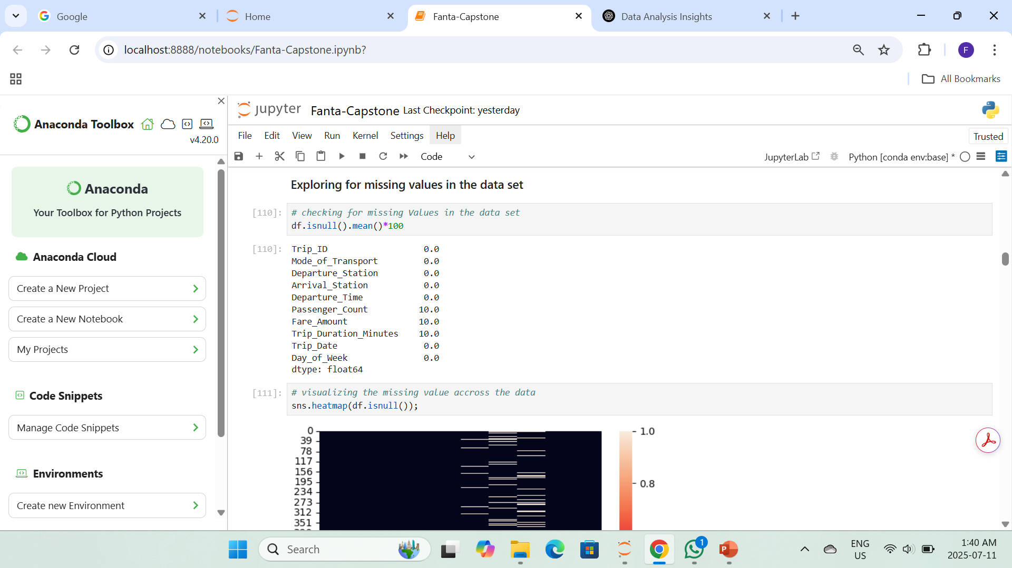
Checking for Missing Values
About 100 missing values in each numerical data column
Overall percentage of missing values is 26.7%.
Dropping the missing values is not ideal.

Slide 8
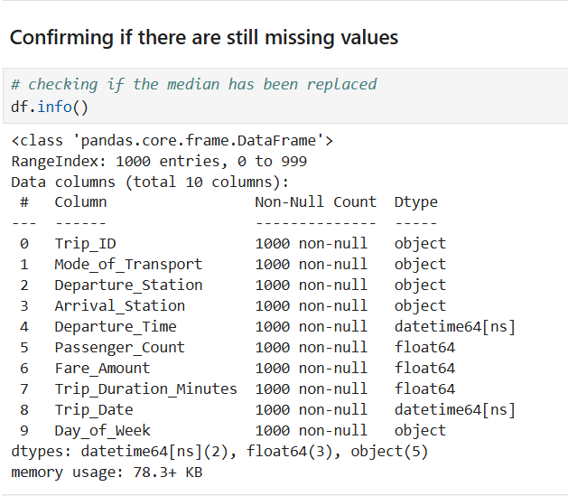
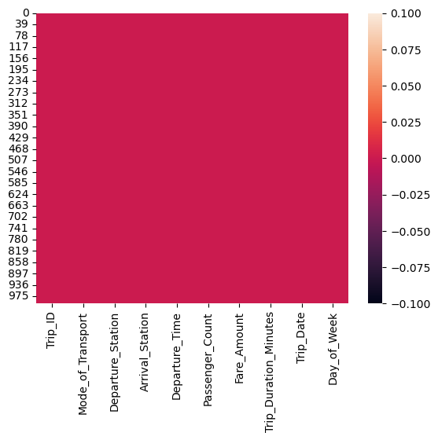
After filling missing values with the median

Slide 9
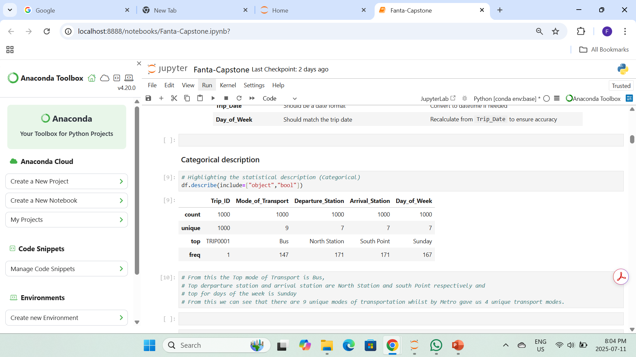
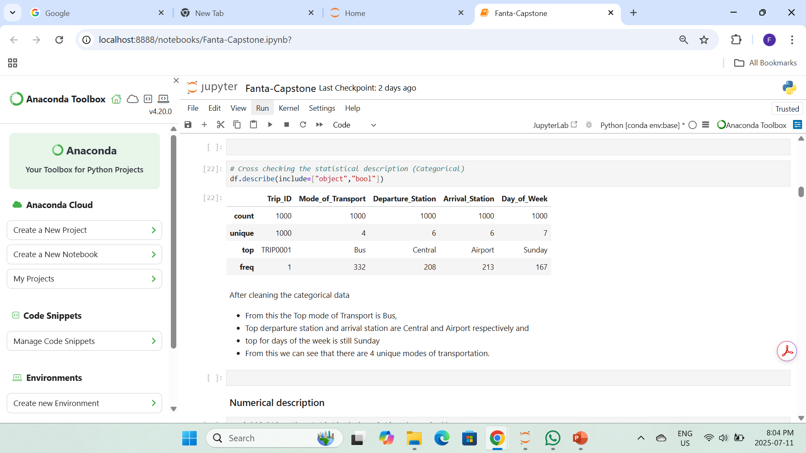
Descriptive Statistics (Categorical)
Before
Overall categorical data count is 1000
Before cleaning the data, the Mode of Transport shows 9 unique modes of transport
After cleaning the data, by looking for inconsistencies, it was observed that we have 4 unique modes of Transport (Ferry, Bus, Train & Tram)
After

Slide 10
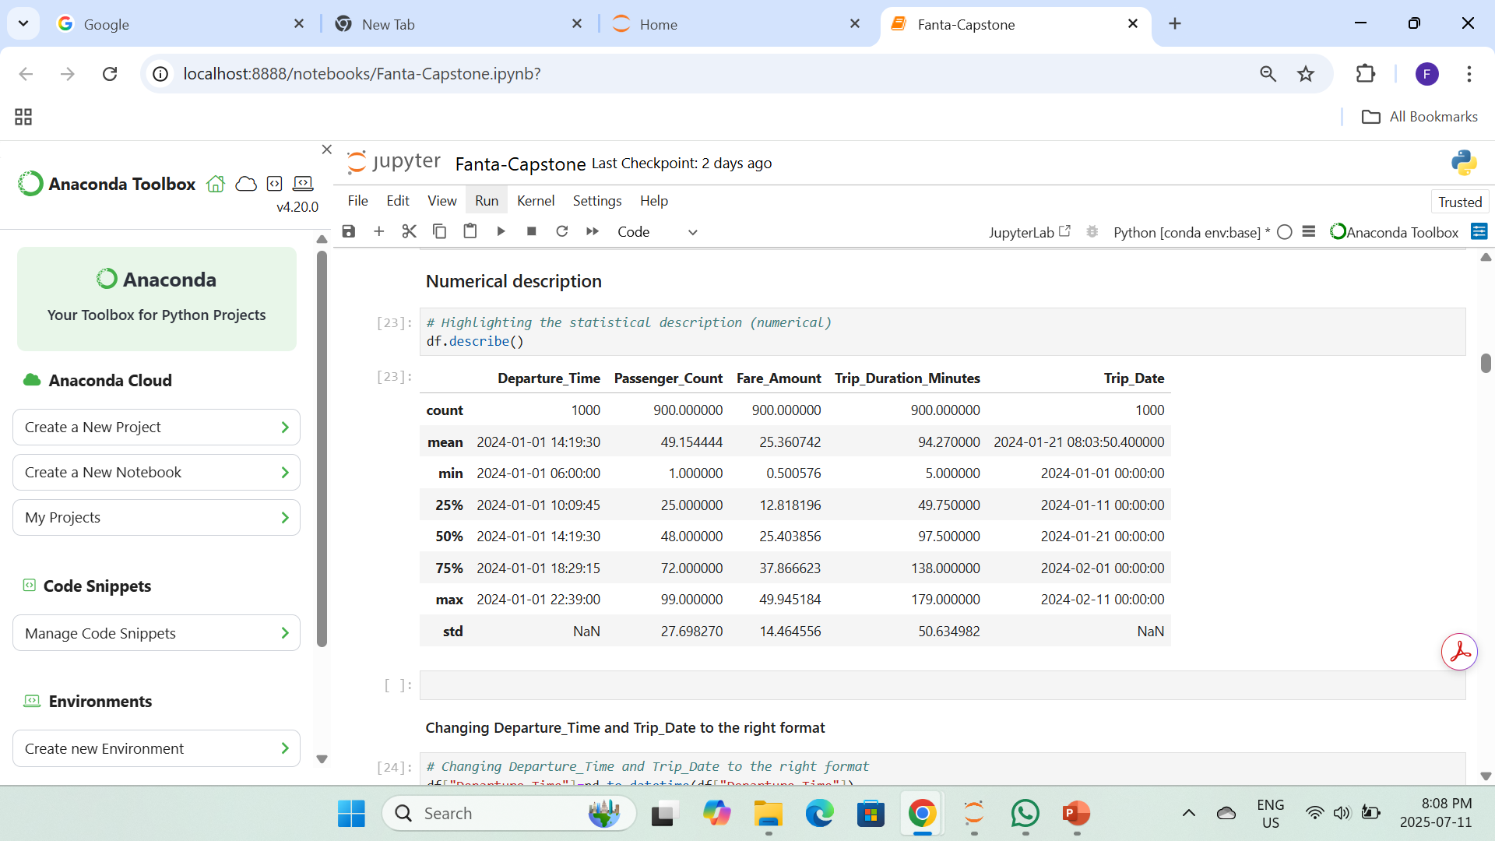
Descriptive Statistics (Numerical)
Before
Raw statistical description of the numerical data before filling missing values

Slide 11
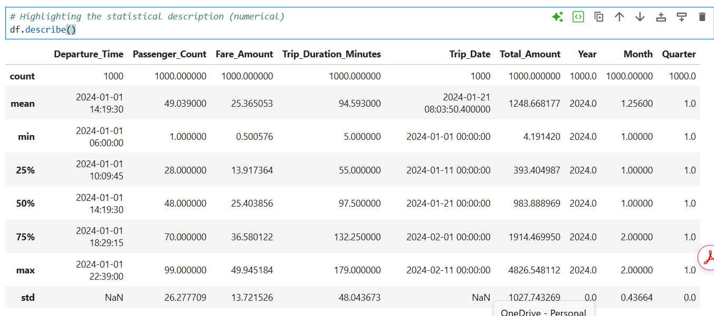
Descriptive Statistics (Numerical)
After
After filling the missing values with the median, changing date to the right form and generating new features like, Total Amount, year, month & Quarter

Slide 12
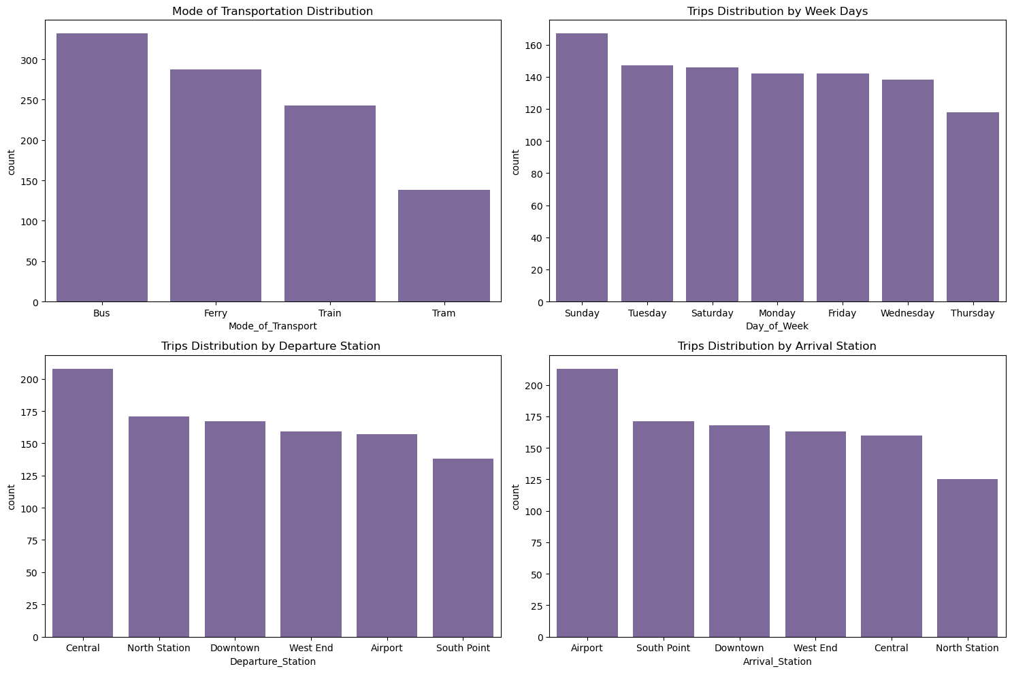
Univariate Analysis (Categorical)
Highest Mode of Transportation is Bus, then Ferry, followed by Train and the lowest is Tram.
Sundays turn out to be the highest travel period and the least is thursday.
Central turns out to be the highest Departure Station, followed by North Station and the Least is South Point
Airport has the highest followed by South point and the least is the North Station

Slide 13
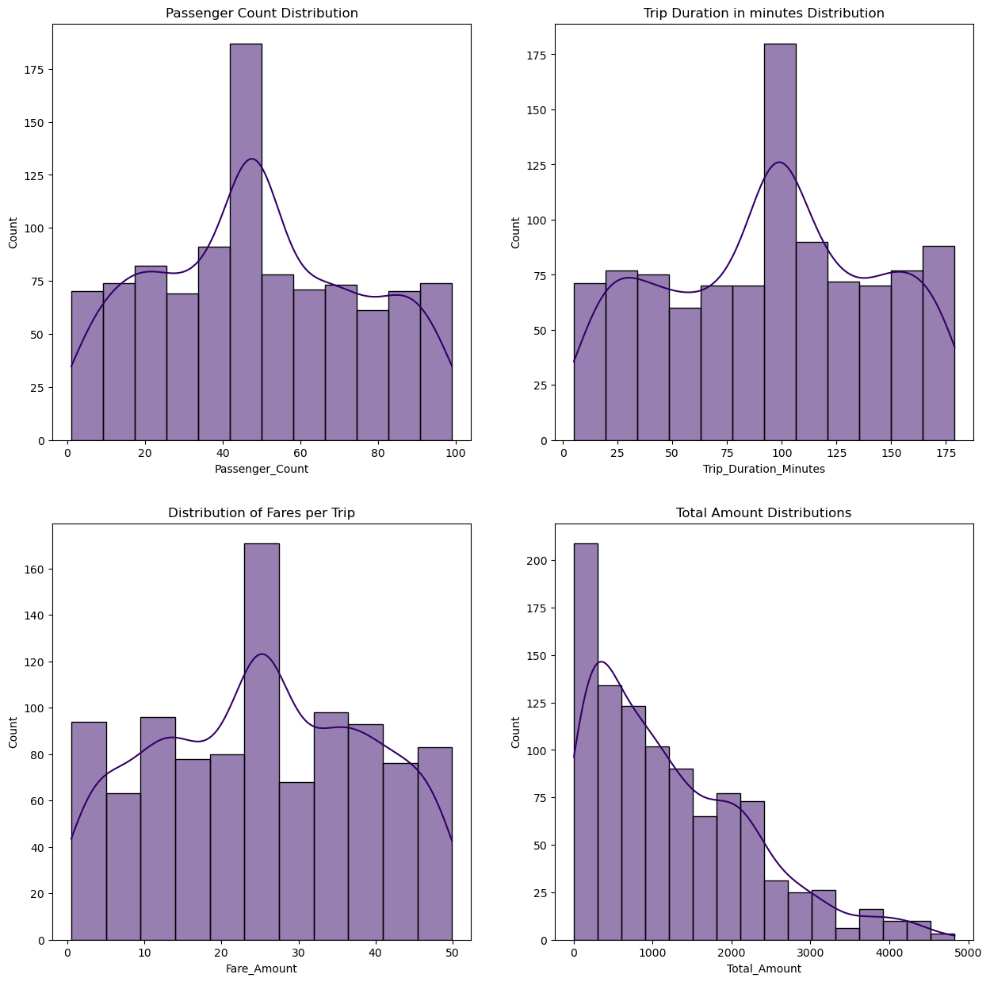
Univariate Analysis (Numerical)
All four distributions show patterns which is typical for a transportation data.
Total Amount is Right-Skewed
The rest are normal distributions
Highest passenger count is around 45 to 50
Highest trip duration is arpunt 100
Modal fare Amount is 25.

Slide 14
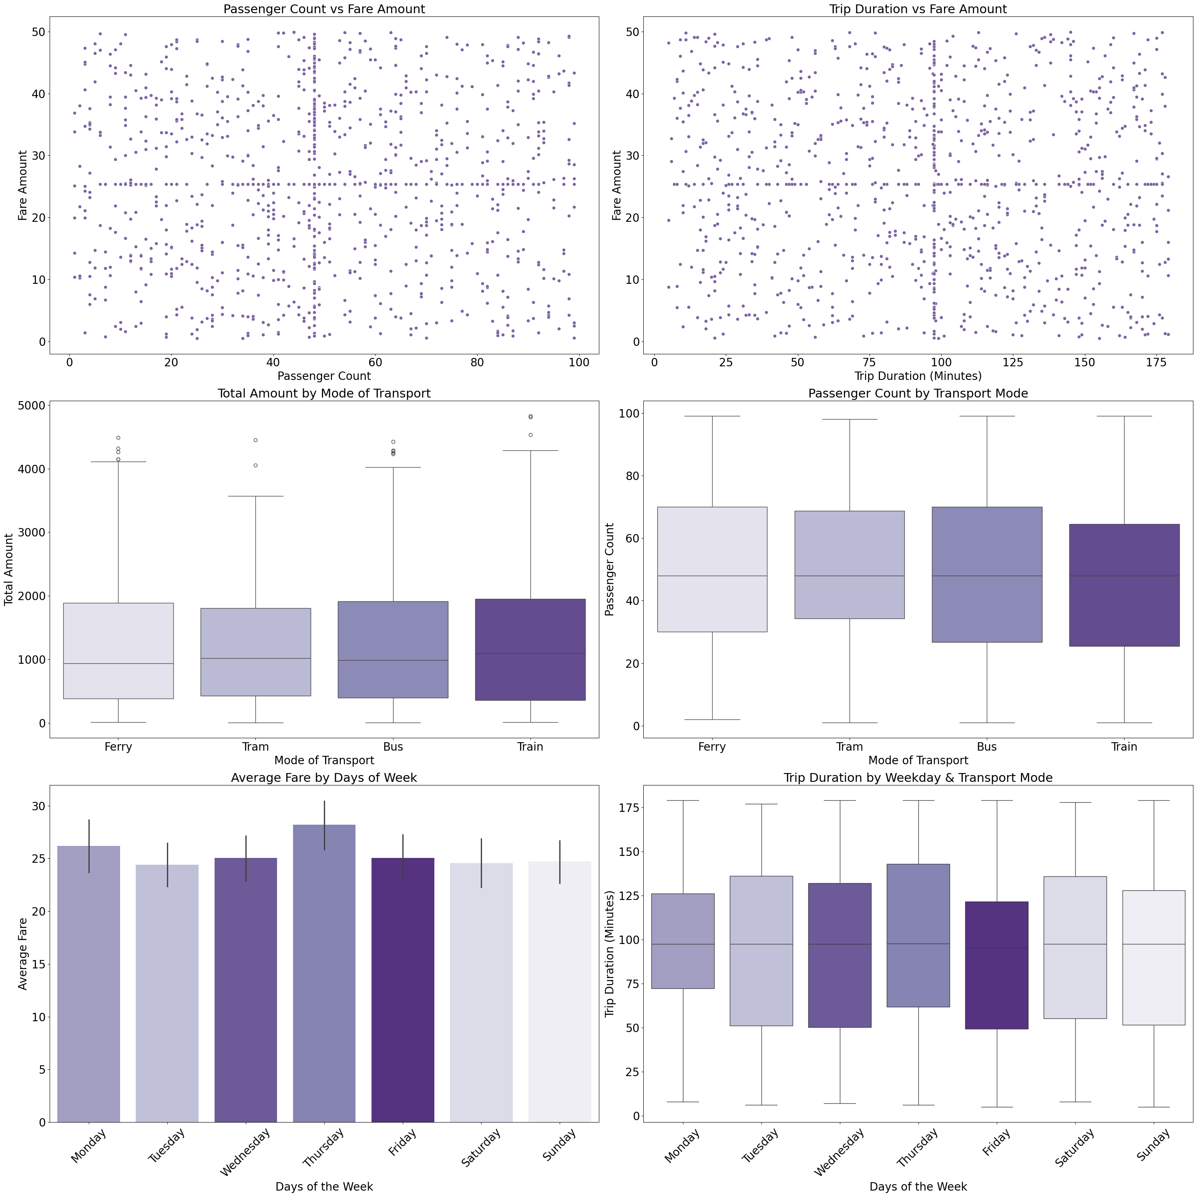
Bivariate Analysis
Observations from the detailed analysis :
Fare Amount Is Not Strongly Influenced by Passenger Count or Trip Duration
Trains and Buses Generate Higher Total Revenue but Show Similar Passenger Counts
Thursday Has the Highest Average Fare and Longest Trip Durations

Slide 15
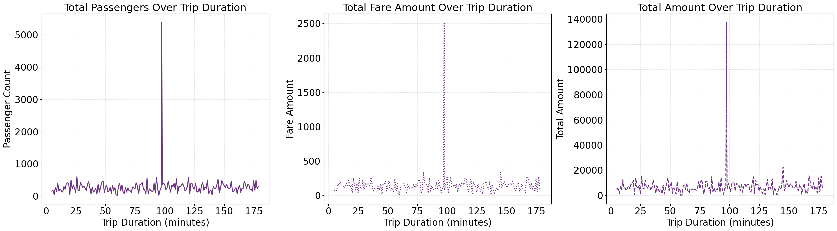
Illustration of Trip Duration vs Passenger count, Fare Amount & Total Amount
Trip Duration of around 100 minutes is the mode with a total passenger count of over 5000, and a fare amount of around 2500 with a Total Amount/revenue of 140,000
Trip duration does not affect Fare Amount, pricing is unaffected by travel time

Slide 16
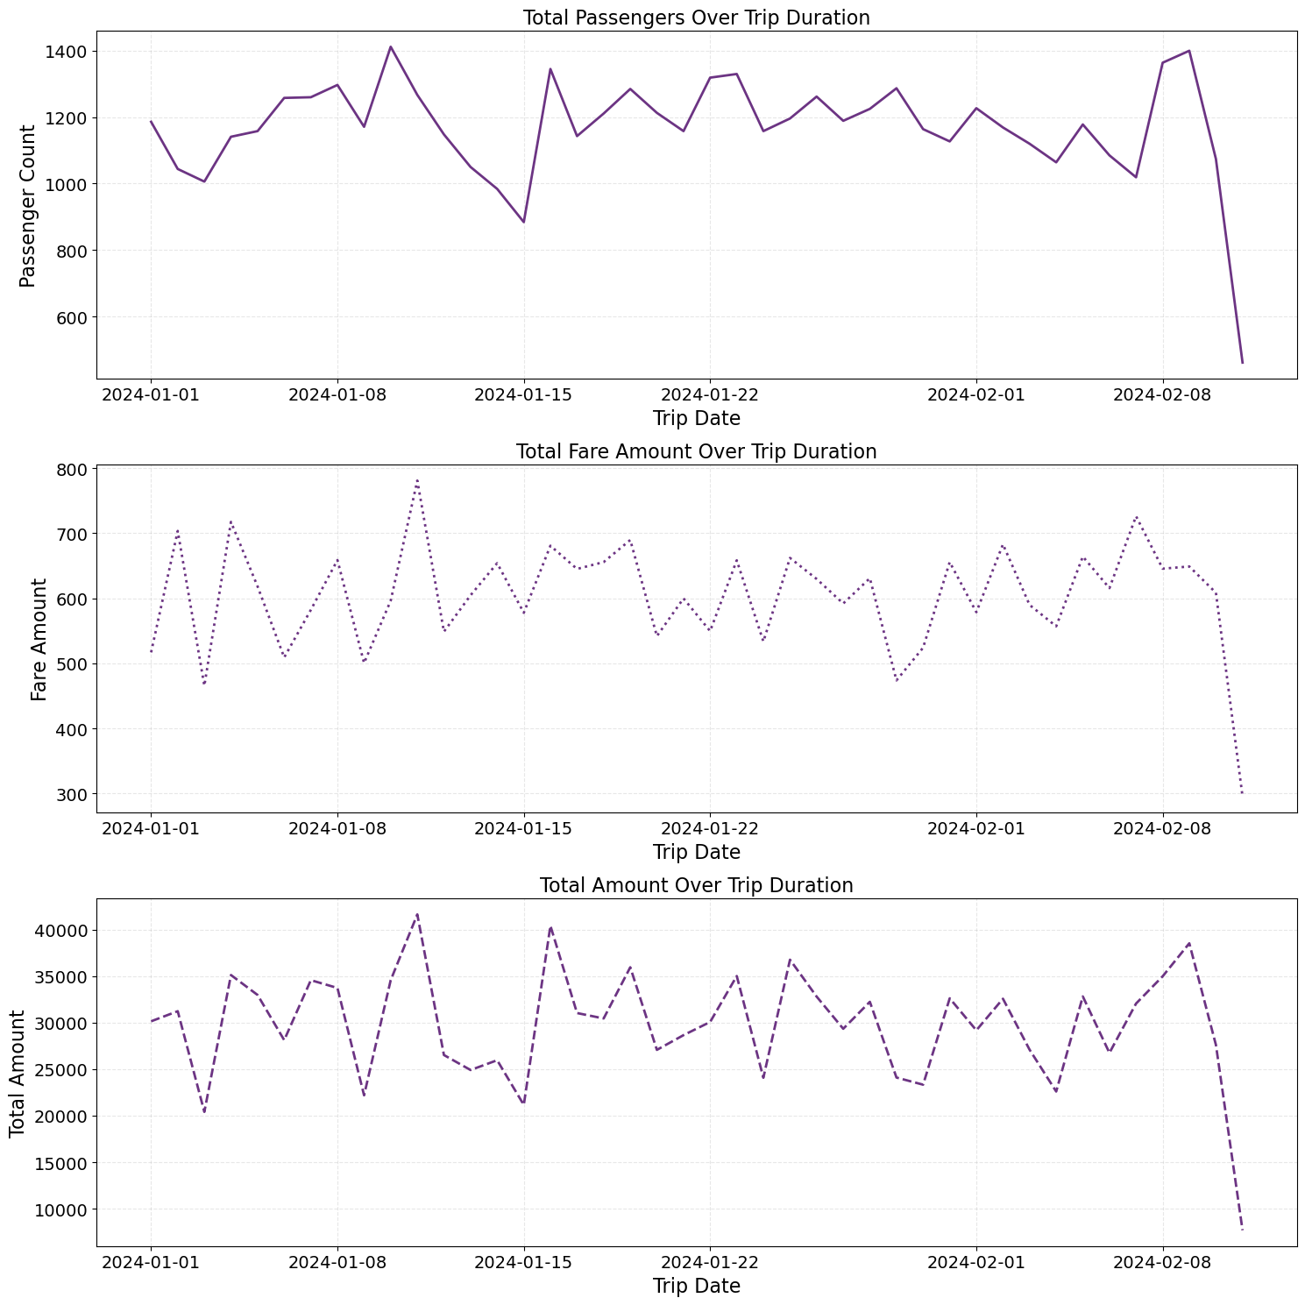
Time Series Analysis
Shows a similar trend between Trip Date vs Total Amount, Passenger count and Fare amount

Slide 17
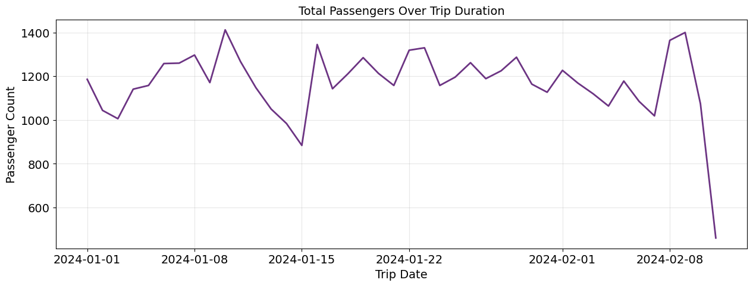
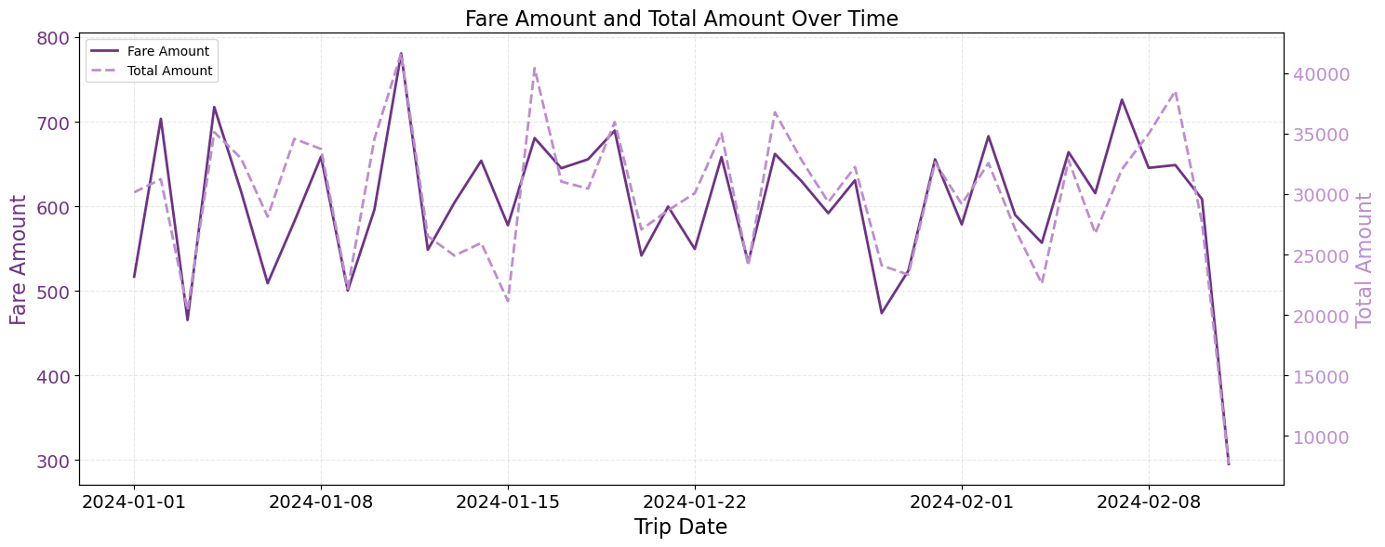
Time Series Analysis
`
Using twin axis to illustrate the how the Trip Date affects Fare & Total Amount
The highest Fare Amount & Total Amount occurs between January 8 and January 10.

Slide 18
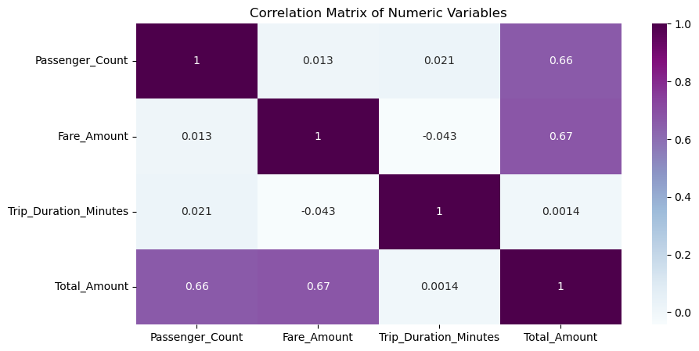
Heatmap Showing the Correlation Matrix
Passenger Count & Total Amount → 0.66-Strong positive correlation
2. Fare Amount & Total Amount → 0.67-Strong positive correlation
3. Passenger Count & Fare Amount → 0.013•-Very weak correlation•
4. Trip Duration Minutes & Fare Amount → -0.043- Slight negative correlation•
.5. Trip Duration Minutes & Total Amount → 0.0014- No correlation

Slide 19
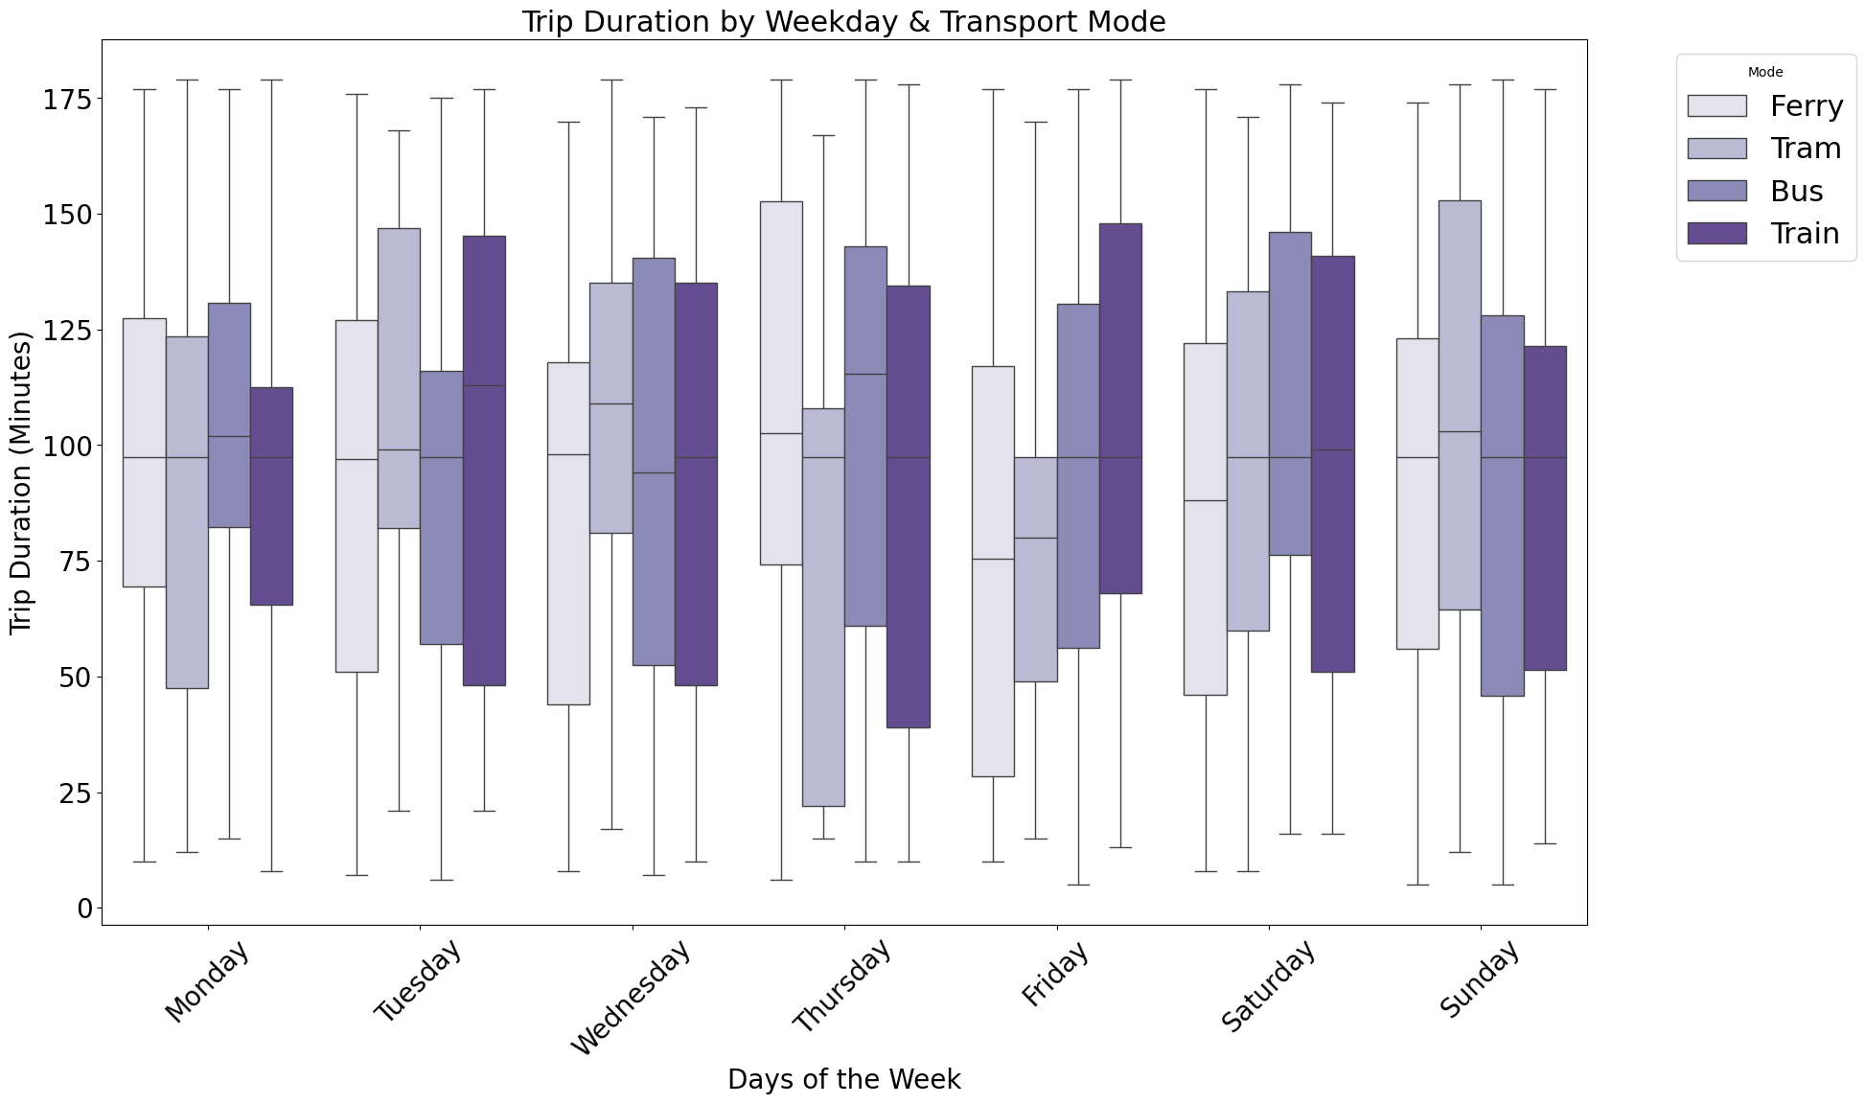
Multi-variate Analysis
Trains consistently have the longest and most variable trip durations across all days of the week.
Ferry trips maintain the most stable and predictable durations regardless of which day passengers travel.
Weekend travel shows reduced duration variability for buses and trams compared to weekdays.

Slide 20
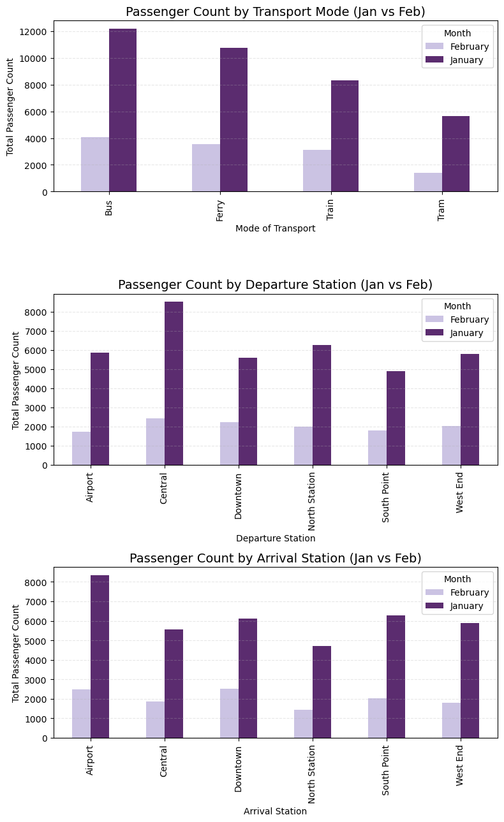
Multi-variate
Analysis
1. January passenger volumes significantly exceed February across all transport modes and stations.
2. Buses carry the highest passenger loads with over 12,000 riders in January.
3. Central station handles the most passenger traffic for both departures and arrivals.

Slide 21
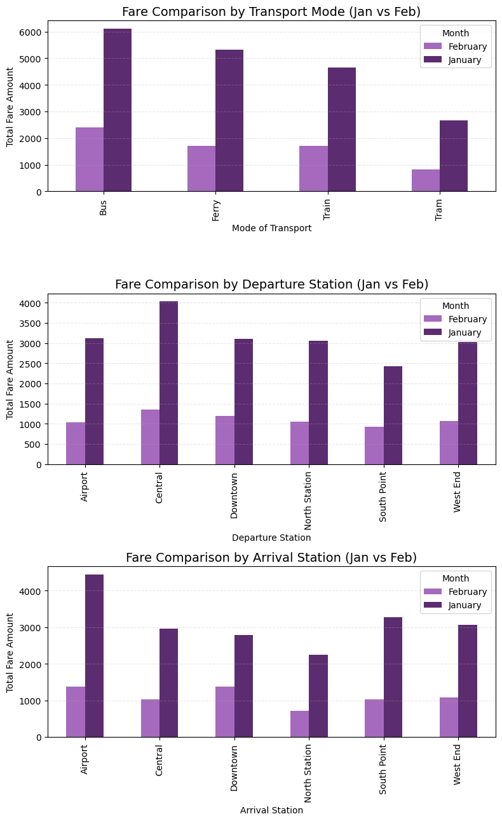
Multi-variate
Analysis
1. January consistently generates higher fare revenue than February across all transport modes and stations.
2. Bus travel produces the highest total fare amounts, especially during January when it exceeds 6000 units.
3. Airport stations demonstrate the most significant seasonal fare variations between January and February.

Slide 22
Conclusions
Fare Amount and Passenger Count Are Primary Revenue Drivers Optimizing pricing strategies and maximizing passenger occupancy directly impact financial performance.
Trip Duration Does Not Influence Fare Significantly Current pricing appears unaffected by travel time, indicating a possible flat-rate system that may not reflect trip value or resource use.
Transport Modes Are Utilized Across Days and Stations Suggesting balanced demand and good service coverage. Weekend travel shows reduced duration variability for buses and trams compared to weekdays.
Day-of-Week and Station Usage Show Minor Variability Slight patterns suggest certain days/stations are marginally more active, which can be explored for targeted improvements.

Slide 23
Recommendations
Implement Dynamic Fare Structures Consider introducing variable pricing based on trip duration or peak/off-peak hours to improve fairness and utilization.
Increase Load Efficiency with Predictive Scheduling Use passenger count data to forecast demand by day, time, and station—then adjust frequency accordingly.
Enhance Route-Level Monitoring and Reporting Develop dashboards for city/route-level performance to identify underperforming or overcrowded segments.
Promote Data-Driven Service Campaigns Use insights from ridership trends to promote specific modes (e.g., off-peak ferry deals) or regions to distribute traffic better.
Adopt Machine Learning for Deeper Analysis Move beyond correlations—apply clustering and prediction models to segment passengers, forecast demand, and detect inefficiencies.

Slide 24
Thank You!!!!

